Slide 1

Branch - CSE Python Programming
Lecture – 21 Tuples – Part 2
By
Dr. Smita Tiwari
Assistant Professor
Department of Computer Science and Engineering
School of Engineering & Technology

Slide 2
Changing a Tuple
Unlike lists, tuples are immutable.
This means that elements of a tuple cannot be changed once they have been assigned.
But, if the element is itself a mutable data type like a list, its nested items can be changed.
We can also assign a tuple to different values (reassignment).

Slide 3
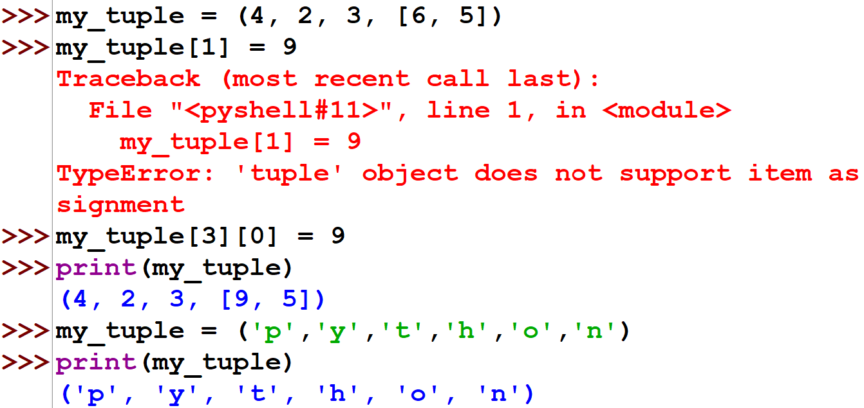
Changing a Tuple

Slide 4
Changing a Tuple
We can use + operator to combine two tuples. This is called concatenation.
We can also repeat the elements in a tuple for a given number of times using the * operator.
Both + and * operations result in a new tuple.

Slide 5
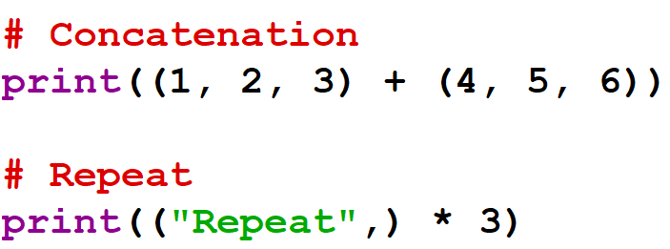
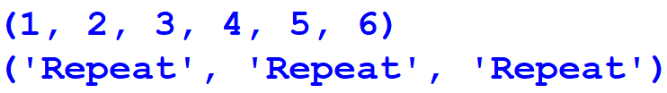
Changing a Tuple
Output:

Slide 6
Deleting a Tuple
As discussed in the previous slides, we cannot change the elements in a tuple. It means that we cannot delete or remove items from a tuple.
Deleting a tuple entirely, however, is possible using the keyword del.

Slide 7
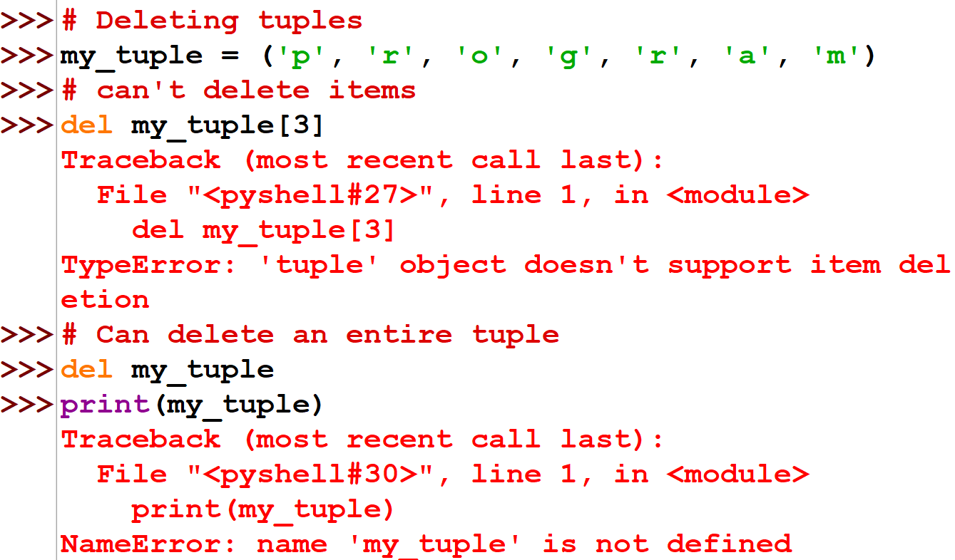

Slide 8
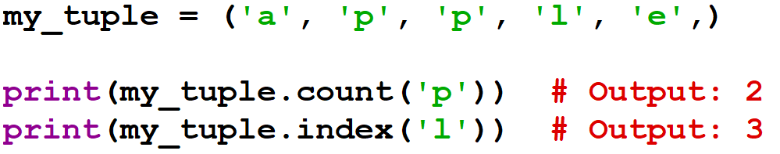
Tuple Methods
Methods that add items or remove items are not available with tuple.
Only the following two methods are available.
Some examples of Python tuple methods:

Slide 9
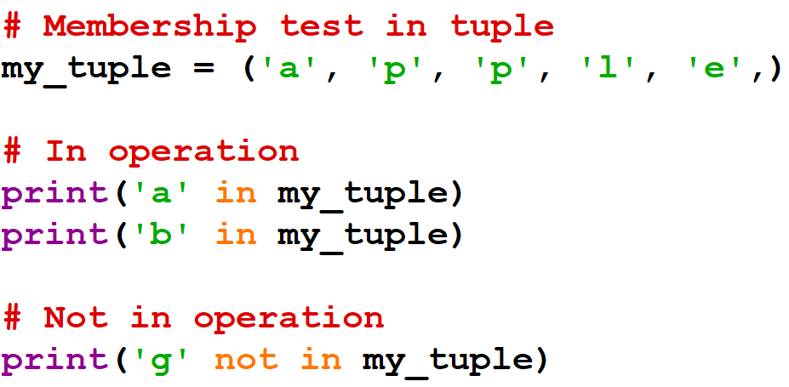
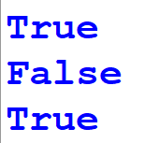
Other Tuple Operations
Tuple Membership Test
We can test if an item exists in a tuple or not, using the keyword in.
Output:

Slide 10
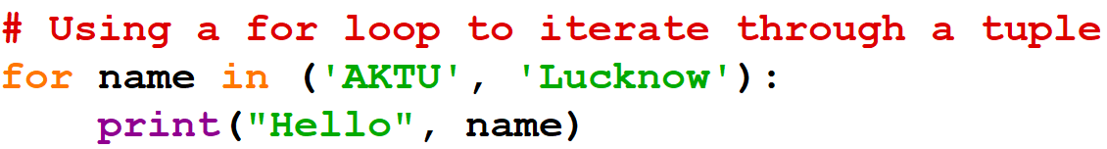

Other Tuple Operations
Iterating Through a Tuple
We can use a for loop to iterate through each item in a tuple.
Output:

Slide 11
Advantages of Tuple over List
Since tuples are quite similar to lists, both are used in similar situations. However, there are certain advantages of implement a tuple over a list. Here are some of the main advantages:
We generally use tuples for heterogeneous (different) data types and lists for homogeneous (similar) data types.
Since tuples are immutable, iterating through a tuple is faster than with list. So, there is a slight performance boost.
Tuples that contain immutable elements can be used as a key for a dictionary. With lists, this is not possible.
If you have data that doesn’t change, implementing it as tuple will guarantee that it remains write-protected.

Slide 12
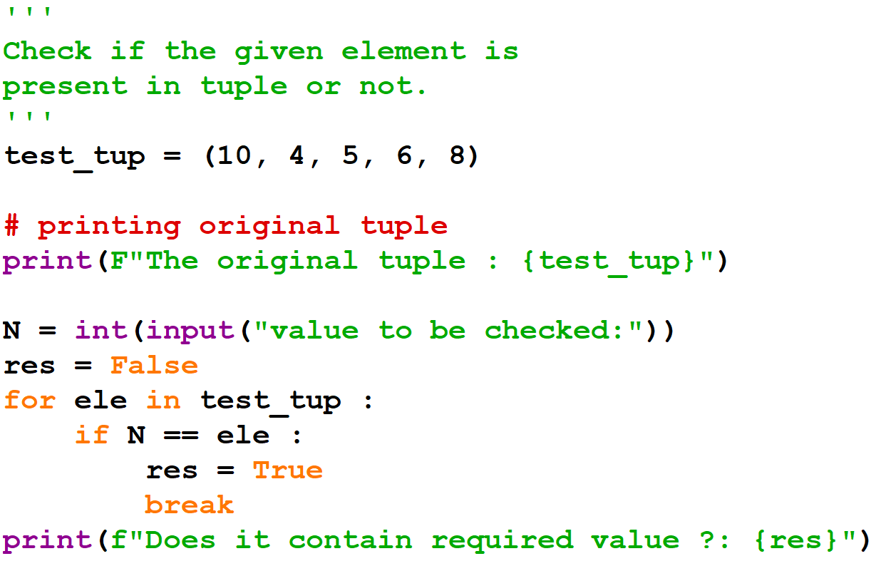
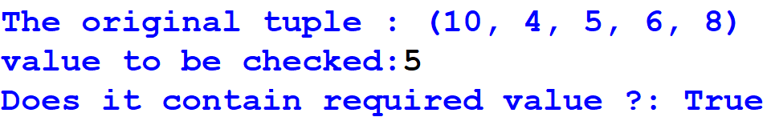
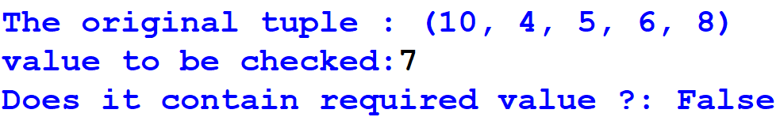
Example
Outputs:

Slide 13
THANK YOU

